Slide 1
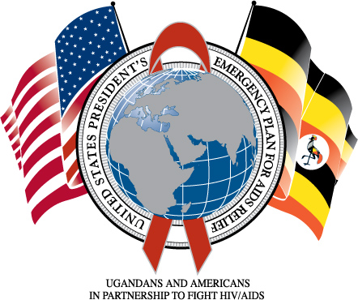
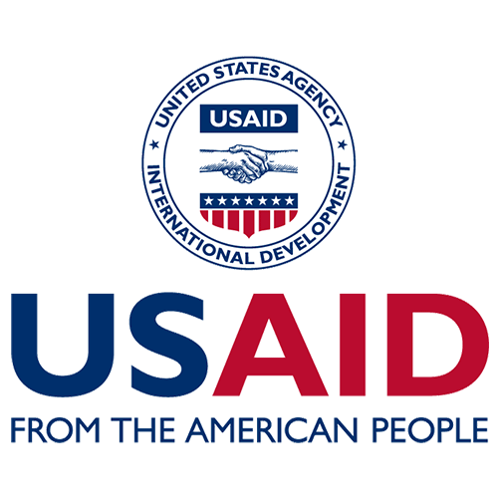



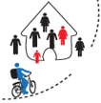






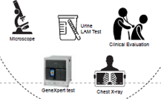
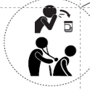



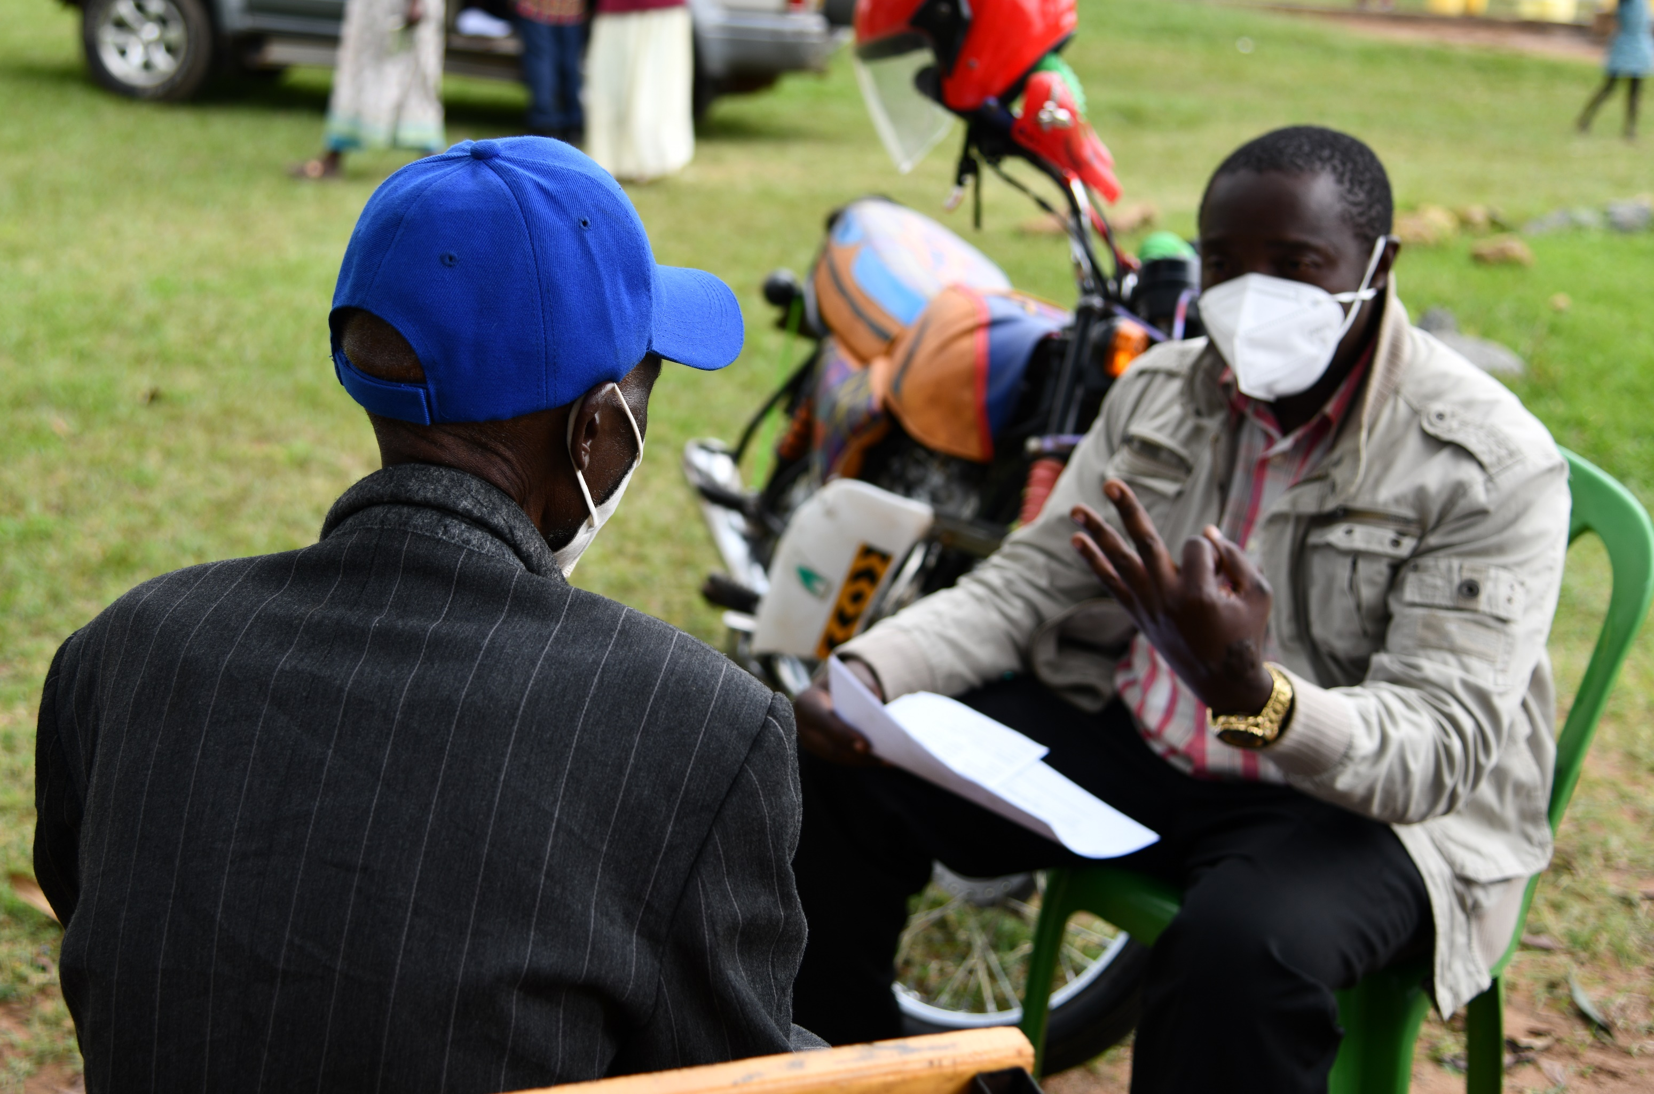




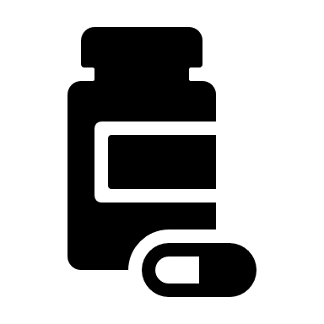
Authors: Clark J Brianwong, Yusuf Namanya, Timothy Kasi, Hellen Aiki, Paul Tumbu
Affiliations: USAID Local Partner Eastern Activity/Baylor Uganda
Ministry of Health
Engaging Community Health Workers to “fish” Missed Tuberculosis cases in Bugisu & Bukedi Regions, Eastern Uganda
Background
80% of Tuberculosis (TB) cases are missed due to facility organization barriers, poor systems of screening for TB, limited access to diagnosis and poor community engagement.
Bukedi/Bugisu, regions earmarked as TB emergency in Jan 2021, had shown consistently low TB case detection rates in FY2021 at 62% of the estimated TB cases worsened by COVID-19 escalation.
In March 2022, the Uganda Ministry of Health (MOH)/ National TB Leprosy Program(NTLP) rolled out the Community Awareness Screening, Testing, Prevention and treatment to end TB (CAST TB) campaign, aimed at catching up with missed TB cases during the COVID-19 pandemic.
Regional IP Microplanning: USAID LPHS-E
Methods
Facility Orientation on CAST TB approach at 4 Diagnostic and Treatment units(DTUs)
Microplanning:
District Health Team to map high burden facilities, 4 facilities in 6 districts
Prioritized districts with 80% of Missed TB cases
Health facility teams map TB High Burden villages and select 10 community health care workers (VHT)
VHT oriented on TB goes for Door-to-door screening
Diagnosed TB patients are started on treatment from the community
Eligible contacts without TB are started on TB preventive therapy
Facility: conducts sputum analysis, initiates treatment, tracks diagnosed patients and support community TB treatment initiation
Samples are collected from Presumptive TB patients and referral for evaluation
VHT sensitizes the Households on TB
Results
126 District Health Team members & 205 health care workers oriented on TB
A health worker engaging a suspected TB patient in Bubuto HCIII, Bubuto Town Council, Namisindwa District, Eastern Uganda.
11664 Households were reached,
20607 individuals screened for TB,
3943 individuals with presumptive TB identified, out of which 299(children) referred for evaluation.
CAST TB
3644 samples collected and referred, 3322 samples were tested using MTB Xpert Ultra and 322 by Microscopy
133 individuals were diagnosed with TB disease and started on TB treatment
This increased the TB case detection rate from 63% in Jan 21 to 103% of estimated TB cases.
237 close TB contacts who screened negative were initiated on TB preventive treatment (TPT)
Conclusion
CAST TB Implementation in the Bugisu/Bukedi region has demonstrated how community-based TB screening driven by community health workers is effective in identifying missed TB cases and scaling up this person-centered approach is an important tool in finding missed TB cases and interrupting community TB transmission.
This poster was printed with the assistance of the American People through the United States Agency for Development (USAID).

