Slide 1




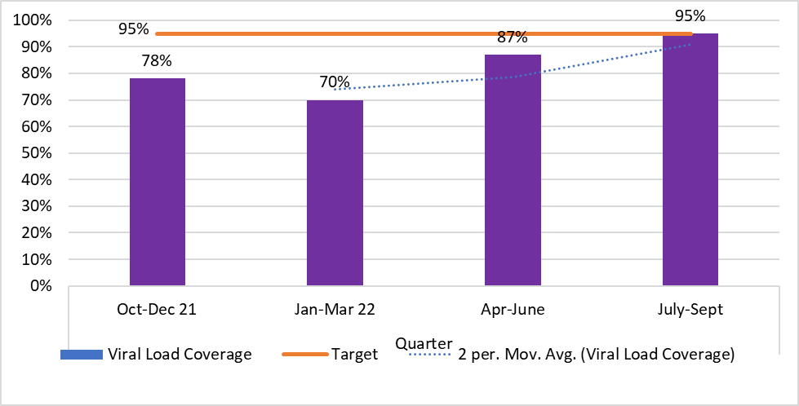
Differentiating HIV Care and Treatment Services to Improve Viral Load Coverage Among PLHIV in Hard to Reach Communities: A Case Study of Kween District, Eastern Uganda
Authors: B. Ainembabazi ¹, W. Akobye ^{1,} Ssekiswa Lwanga Z ¹ S. Okot ¹ S. Chemusto ² A. Katawera ¹, P. Tumbu¹
Affiliation: USAID Local Partner Health Services – Eastern Activity (LPHS-E)¹, Kween District Local Government²
Ministry of Health
Introduction
Results
Between January and March 2022, Kween district registered suboptimal viral load (VL) coverage of 70%. This was below the national standard of 95%
As a result, the VL suppression (VLS) was poor at 55%, attributed to inability to intervene with tailored messages to sustain good adherence and VLS
The USAID LPHS-E project set out to address bottlenecks to close the gap in VL coverage in Kween District,
Methods
A root cause analysis involving lay and skilled facility staff, client representatives, district supervisors and LPHS-E staff was conducted.
Contributing factors were identified as client related; migration to low lands during the planting season, lack of awareness on VL testing and health provider related; knowledge gap among service providers on VL testing timelines, home - based ART delivery without incorporation of VL testing and multi month dispensing (MMD)
Both EMR and chart audits were utilized to generate lists of those who were eligible for VL testing. These were attached to both facility and community health workers for follow up.
Facility based mentorships on VL monitoring among PLHIV were conducted
Clinicians, laboratory staff and case management assistants were involved in mobilization and bleeding of clients in the community.
Facility meetings were held to support teams implement their roles and meet agreed upon targets
Client audit tool use and weekly tracking of clients bled using the Uganda VL dashboard was done
Viral load coverage (all age groups) improved from 70% in Jan-March 2022 to 95% by July-September 2022.
Discussion
VL coverage improved from 70% in Jan - March 2022 to the national standard of 95% by July-September 2022.
This was attributed to weekly client audits, improved mobilization through assigning clients to community health workers and task shifting to enhance service access.
Conclusion
Differentiating care by providing services in the community and task shifting improves services’ uptake including VL testing, and should be scaled up.
Lessons learnt
Weekly client audits support the clinic team to determine service gaps
Assigning clients to community health workers eases client tracking and mobilization for service provision.
Acknowledgements
1. USAID Local Partner Health Services- Eastern Activity (LPHS-E) 2. Baylor College of Medicine Children’s Foundation – Uganda 3. Kween District Local Government
This poster was printed with the assistance of the American People through the United States Agency for Development (USAID).

